Slide 1
Computational Prediction of Boundaries of 3D Genomic Domains in Class Imbalance Settings
Spiro C. Stilianoudakis¹ (stilianoudasc@mymail.vcu.edu)
Mikhail G. Dozmorov¹ (mikhail.dozmorov@vcuhealth.org)
¹Dept. of Biostatistics, Virginia Commonwealth University, Richmond, VA, 23298, USA

Slide 2
Outline
Spatial organization of the human genome
Epigenomic marks
Binding peaks
Topologically associated domains (TADs)
Addressing data irregularities and characteristics
Establishing relationships between epigenomic features and TADs
Class imbalance issues
Predictive Modelling
Suitable performance metrics
Identifying most informative features
Conclusions
Future Work

Slide 3
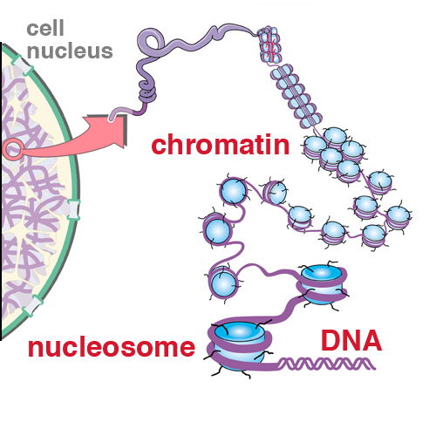
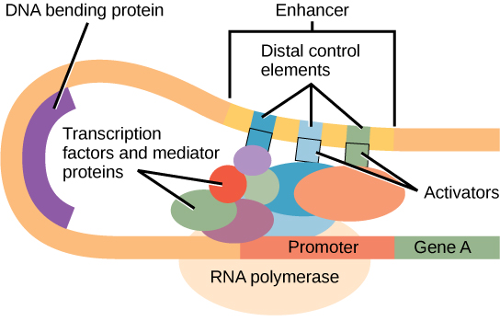
The Human Genome
The genome is composed of 22 pairs of autosomal chromosomes
Composed of approximately 3 billion base pairs (A/T/C/G)
DNA must create compact loops to fit inside the nucleus of a cell

Slide 4
Epigenomic Annotations
Protein coding genes only account for about 1% of the DNA sequences in the human genome.
Epigenomic maps are the set of sequences that account for a variety of modifications on the genetic material of a cell
They provide an opportunity to identify and understand how chromosomal structures act throughout the other 99% of the genome
Consists of chromatin states, histone modifications, transcription factor binding sites, DNAse I hypersensitive sites, etc.
Notes:
These modifications play an important role in stability of eukaryotic genomes by taking part in crucial biological mechanisms like DNA repair and gene expression/regularization.

Slide 5
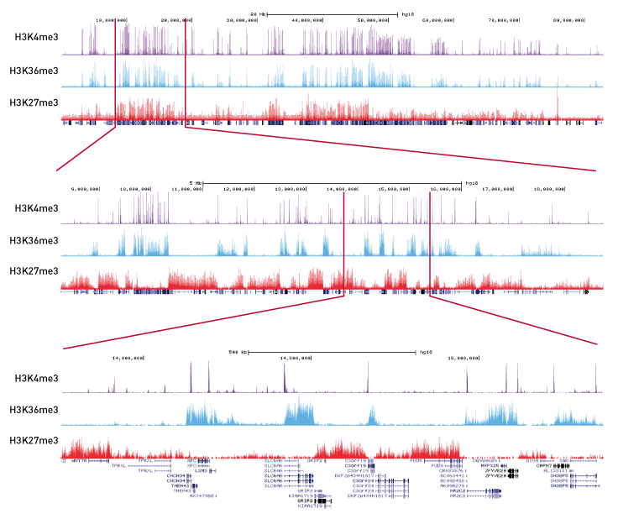
Chromatin mapping technologies
ChIP-sequencing (ChIP-Seq)
Combines chromatin immunoprecipitation (ChIP) with massively parallel DNA sequencing
Determines how transcription factors and other chromatin-associated proteins influence phenotype-affecting mechanisms

Slide 6
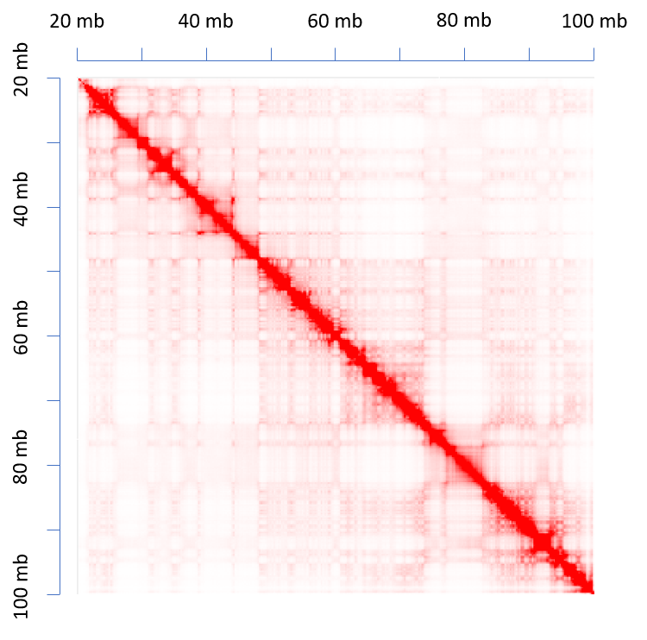
Chromatin mapping technologies
Chromosome conformation capture techniques
A set of molecular biology methods used to analyze the spatial organization of chromatin in a cell.
Quantify the number of interactions between genomic loci that are nearby in 3-D space, but may be separated by many nucleotides in the linear genome

Slide 7
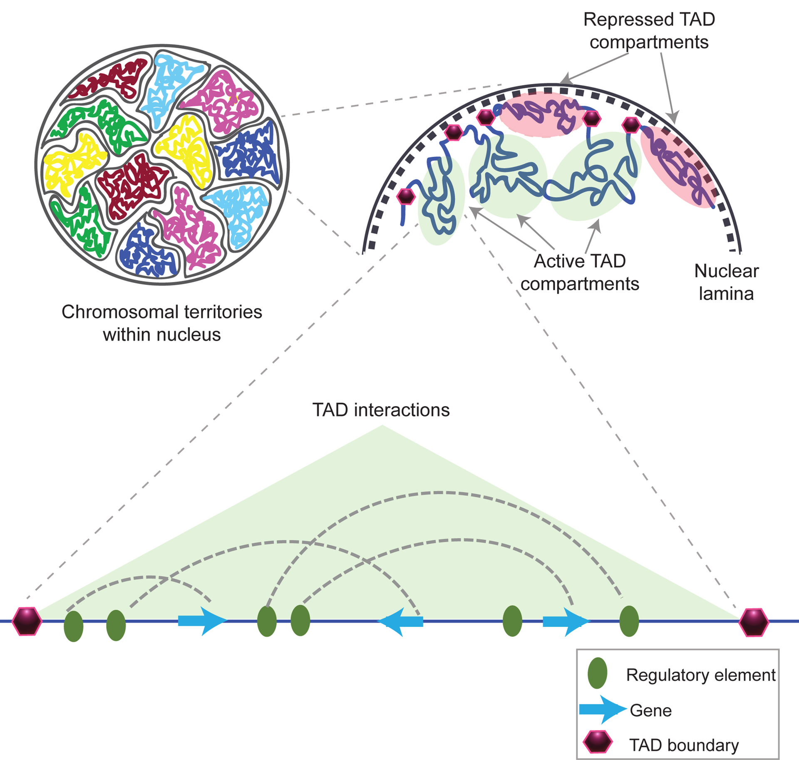
Topologically Associating Domains
Hi-C sequencing technologies have shown that the genome is tightly compacted into distinct compartments termed topologically associating domains (TADs)

Slide 8
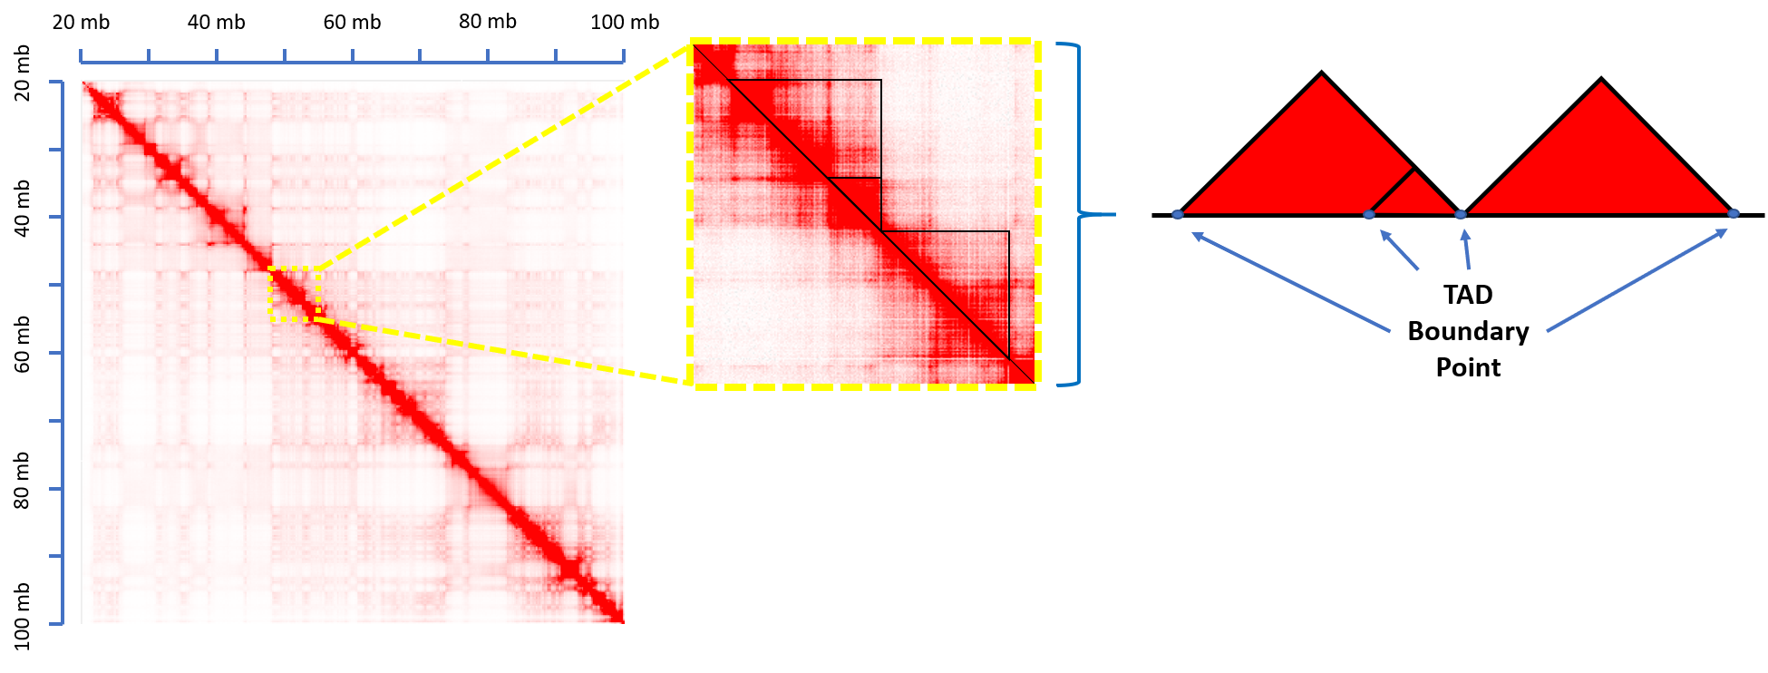
TAD Calling Algorithms

Slide 9
Characteristics of TADs
More info

Slide 10
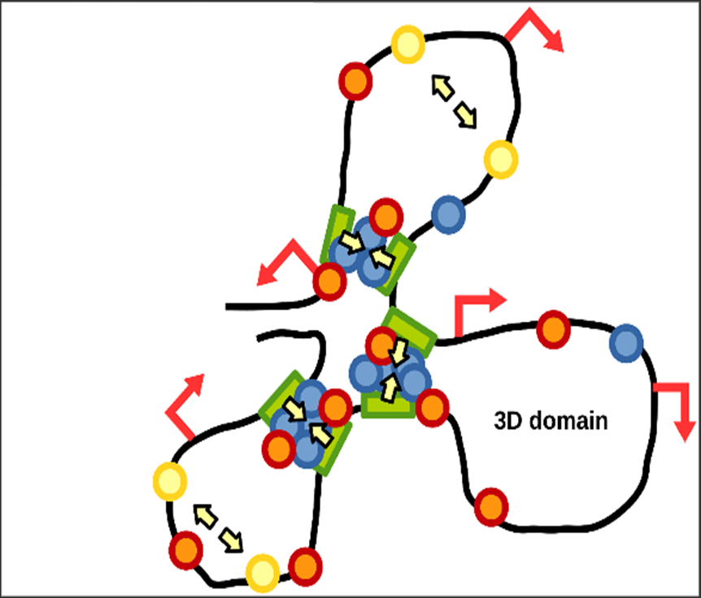
Relating TADs to epigenomic annotations
More info

Slide 11
Using epigenomic annotations to predict TAD formation
We aim to create a classification algorithm that efficiently and correctly identifies the functional genomic elements most predictive of the formation of TAD boundaries
Create and ensemble framework in which we answer the following questions:
How severe is class imbalance?
What type of predictors improve model performance?
Which functional genomic elements are most predictive of TAD boundaries?

Slide 12
Domain Data Source
Publicly available Replicate Hi-C data was obtained for the GM12878 and K562 cell lines from GEO GSE63525
The autosomal genomic coordinates (GRCh37/hg19 human genome assembly) of TAD boundaries were obtained from data at 10 kb, 25 kb, 50 kb, and 100 kb resolution using the Arrowhead algorithm (developed by Rao et. al (2014))
Identified TAD boundaries were represented by their genomic coordinates.

Slide 13
Genomic Annotation Data Source
Genomic annotation data were obtained from the UCSC Genome Browser Database
Consisted of:
Chromatin states
Histone marks
Rranscription factor binding sites
DNAse Hypersensitive Sites

Slide 14
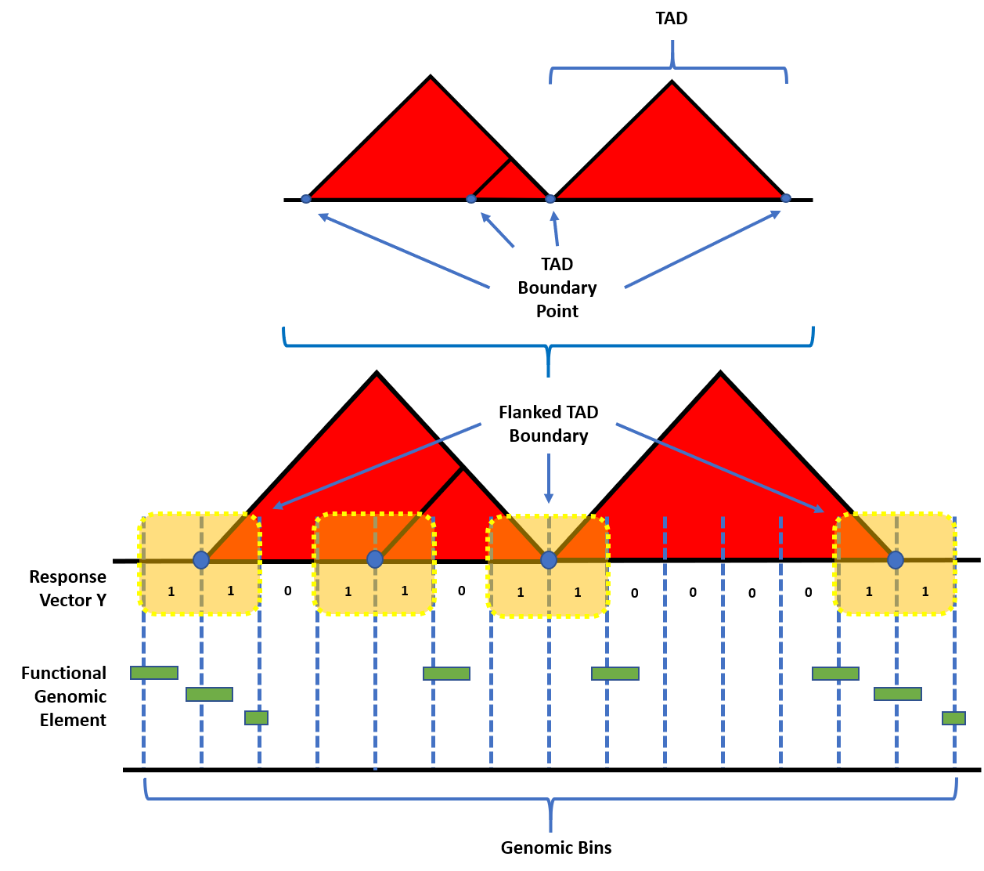
Model Construction: Establishing the response
More info

Slide 15
Model Construction: Re-sampling Techniques
No Sampling: All of the data points from the majority and minority class of the training set were used.

Slide 16
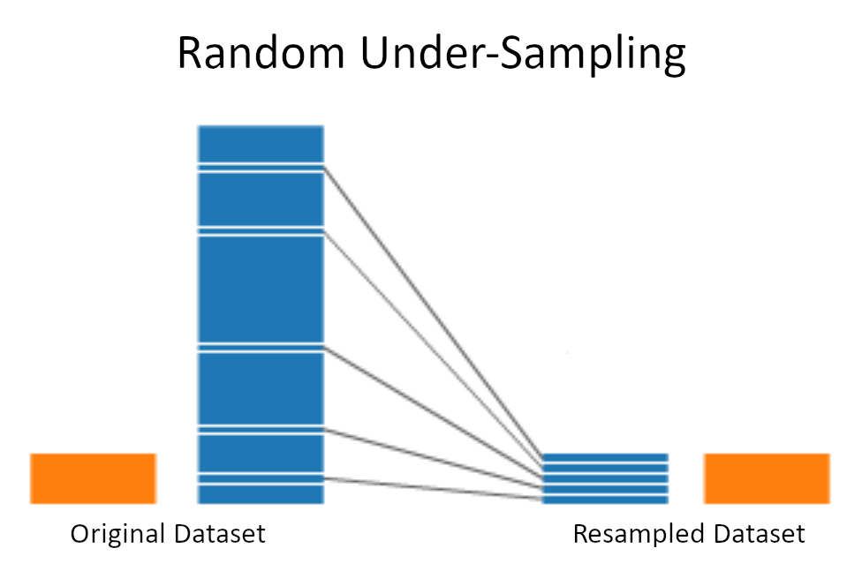
Model Construction: Re-sampling Techniques
Random Under-Sampling (RUS): All of the minority classes from the training set were used. Sampling without replacement was used to obtain the same number of the majority classes.

Slide 17
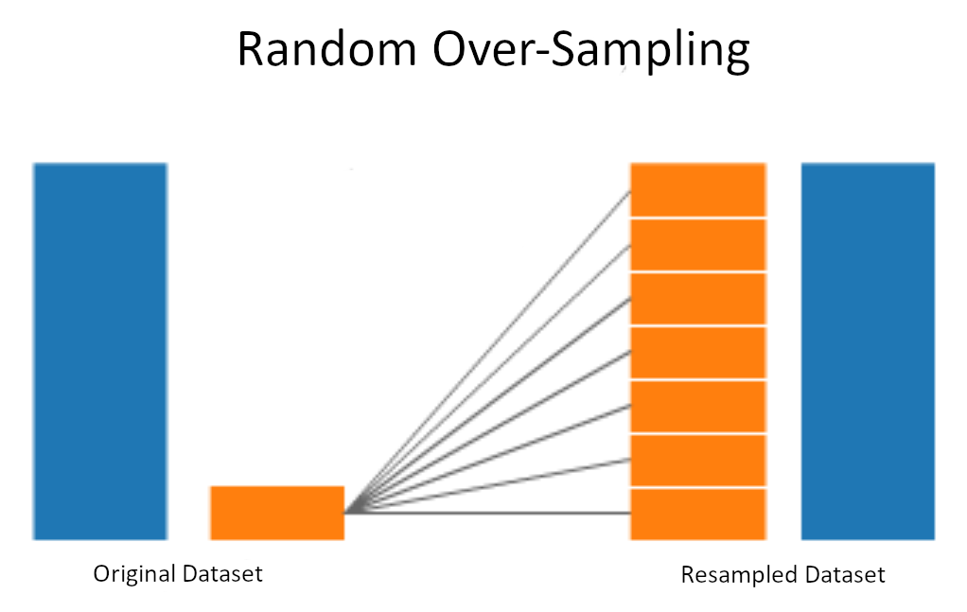
Model Construction: Re-sampling Techniques
Random Over-Sampling (ROS): All of the majority classes from the training set were used. Sampling with replacement was used to obtain the same number of the minority classes.

Slide 18
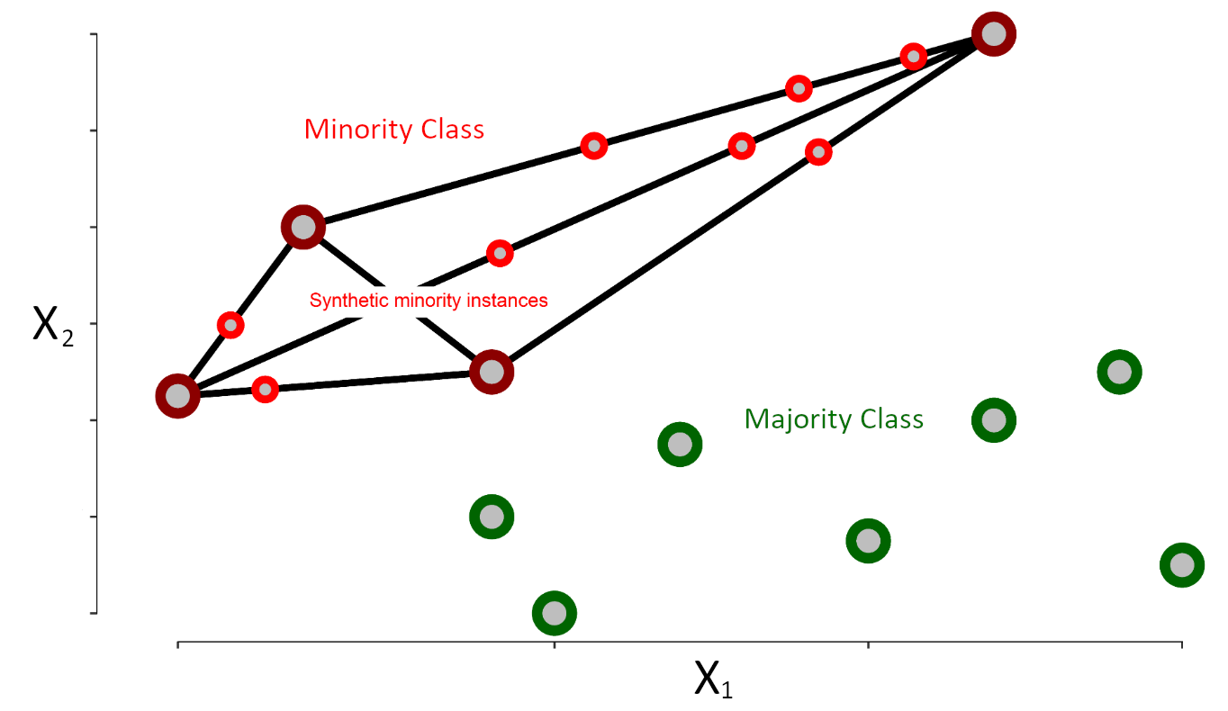
Model Construction: Re-sampling Techniques
SMOTE (Synthetic Minority Over-Sampling Technique): Incorporates both random under- and over-sampling. Under-sampling is performed without replacement from the majority class, while over-sampling is performed by creating new synthetic observations using the minority class. The DMwR R package was used to perform SMOTE (version 0.4.1).

Slide 19
Model Construction: Feature engineering
More info

Slide 20
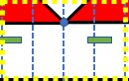
Model Construction: Predictor Types
Overlap Counts
1
0
1
1

Slide 21
Model Construction: Predictor Types
Overlap Percents
Feature Width
Bin Width

Slide 22
Model Construction: Predictor Types
Log₂ Distance
D₁
D₂
D₃
D₄

Slide 23
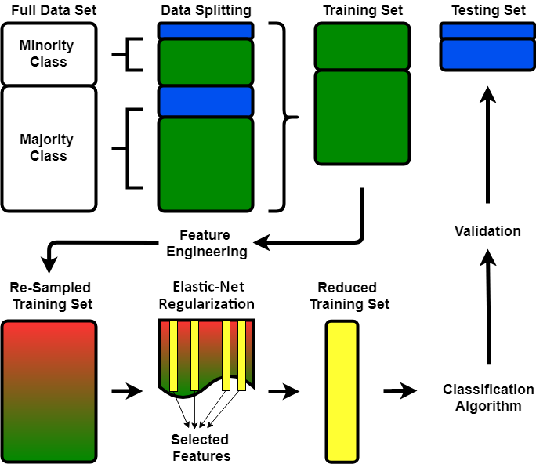
Ensemble Framework
More info

Slide 24
Predicting TAD Boundary Formation

Slide 25
Final Model Assessment and Performance

Slide 26
Complete ensemble comparisons

Slide 27
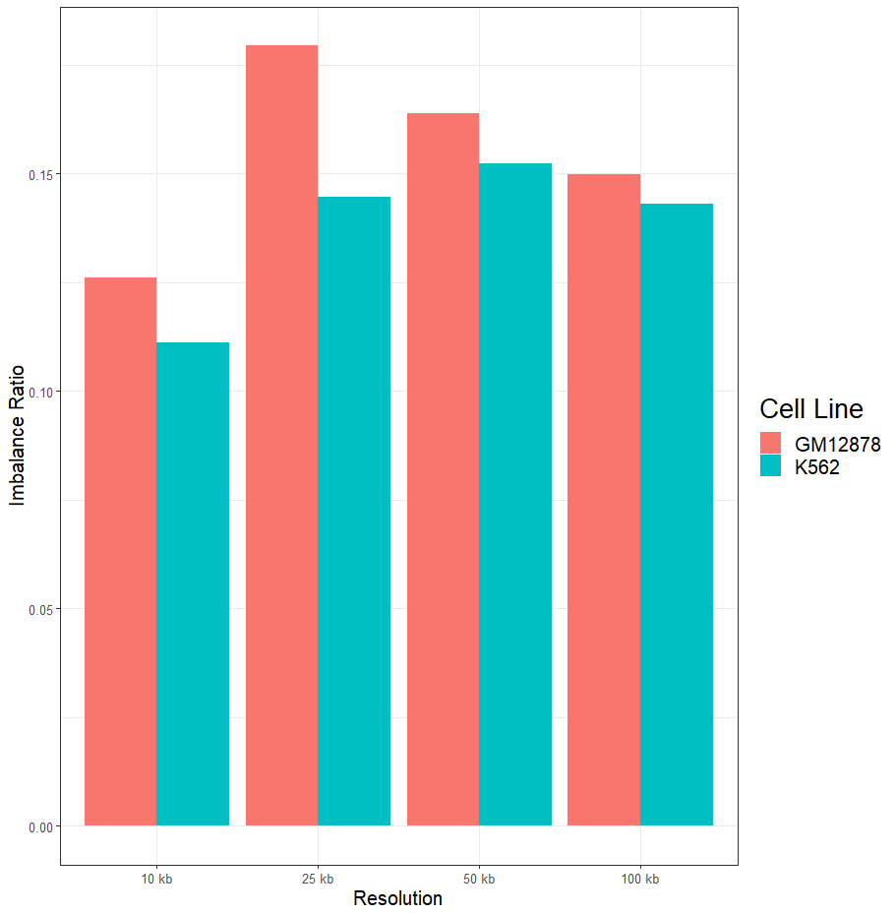
Imbalance Ratios Remained Severe & Consistent Across Resolutions
More info

Slide 28
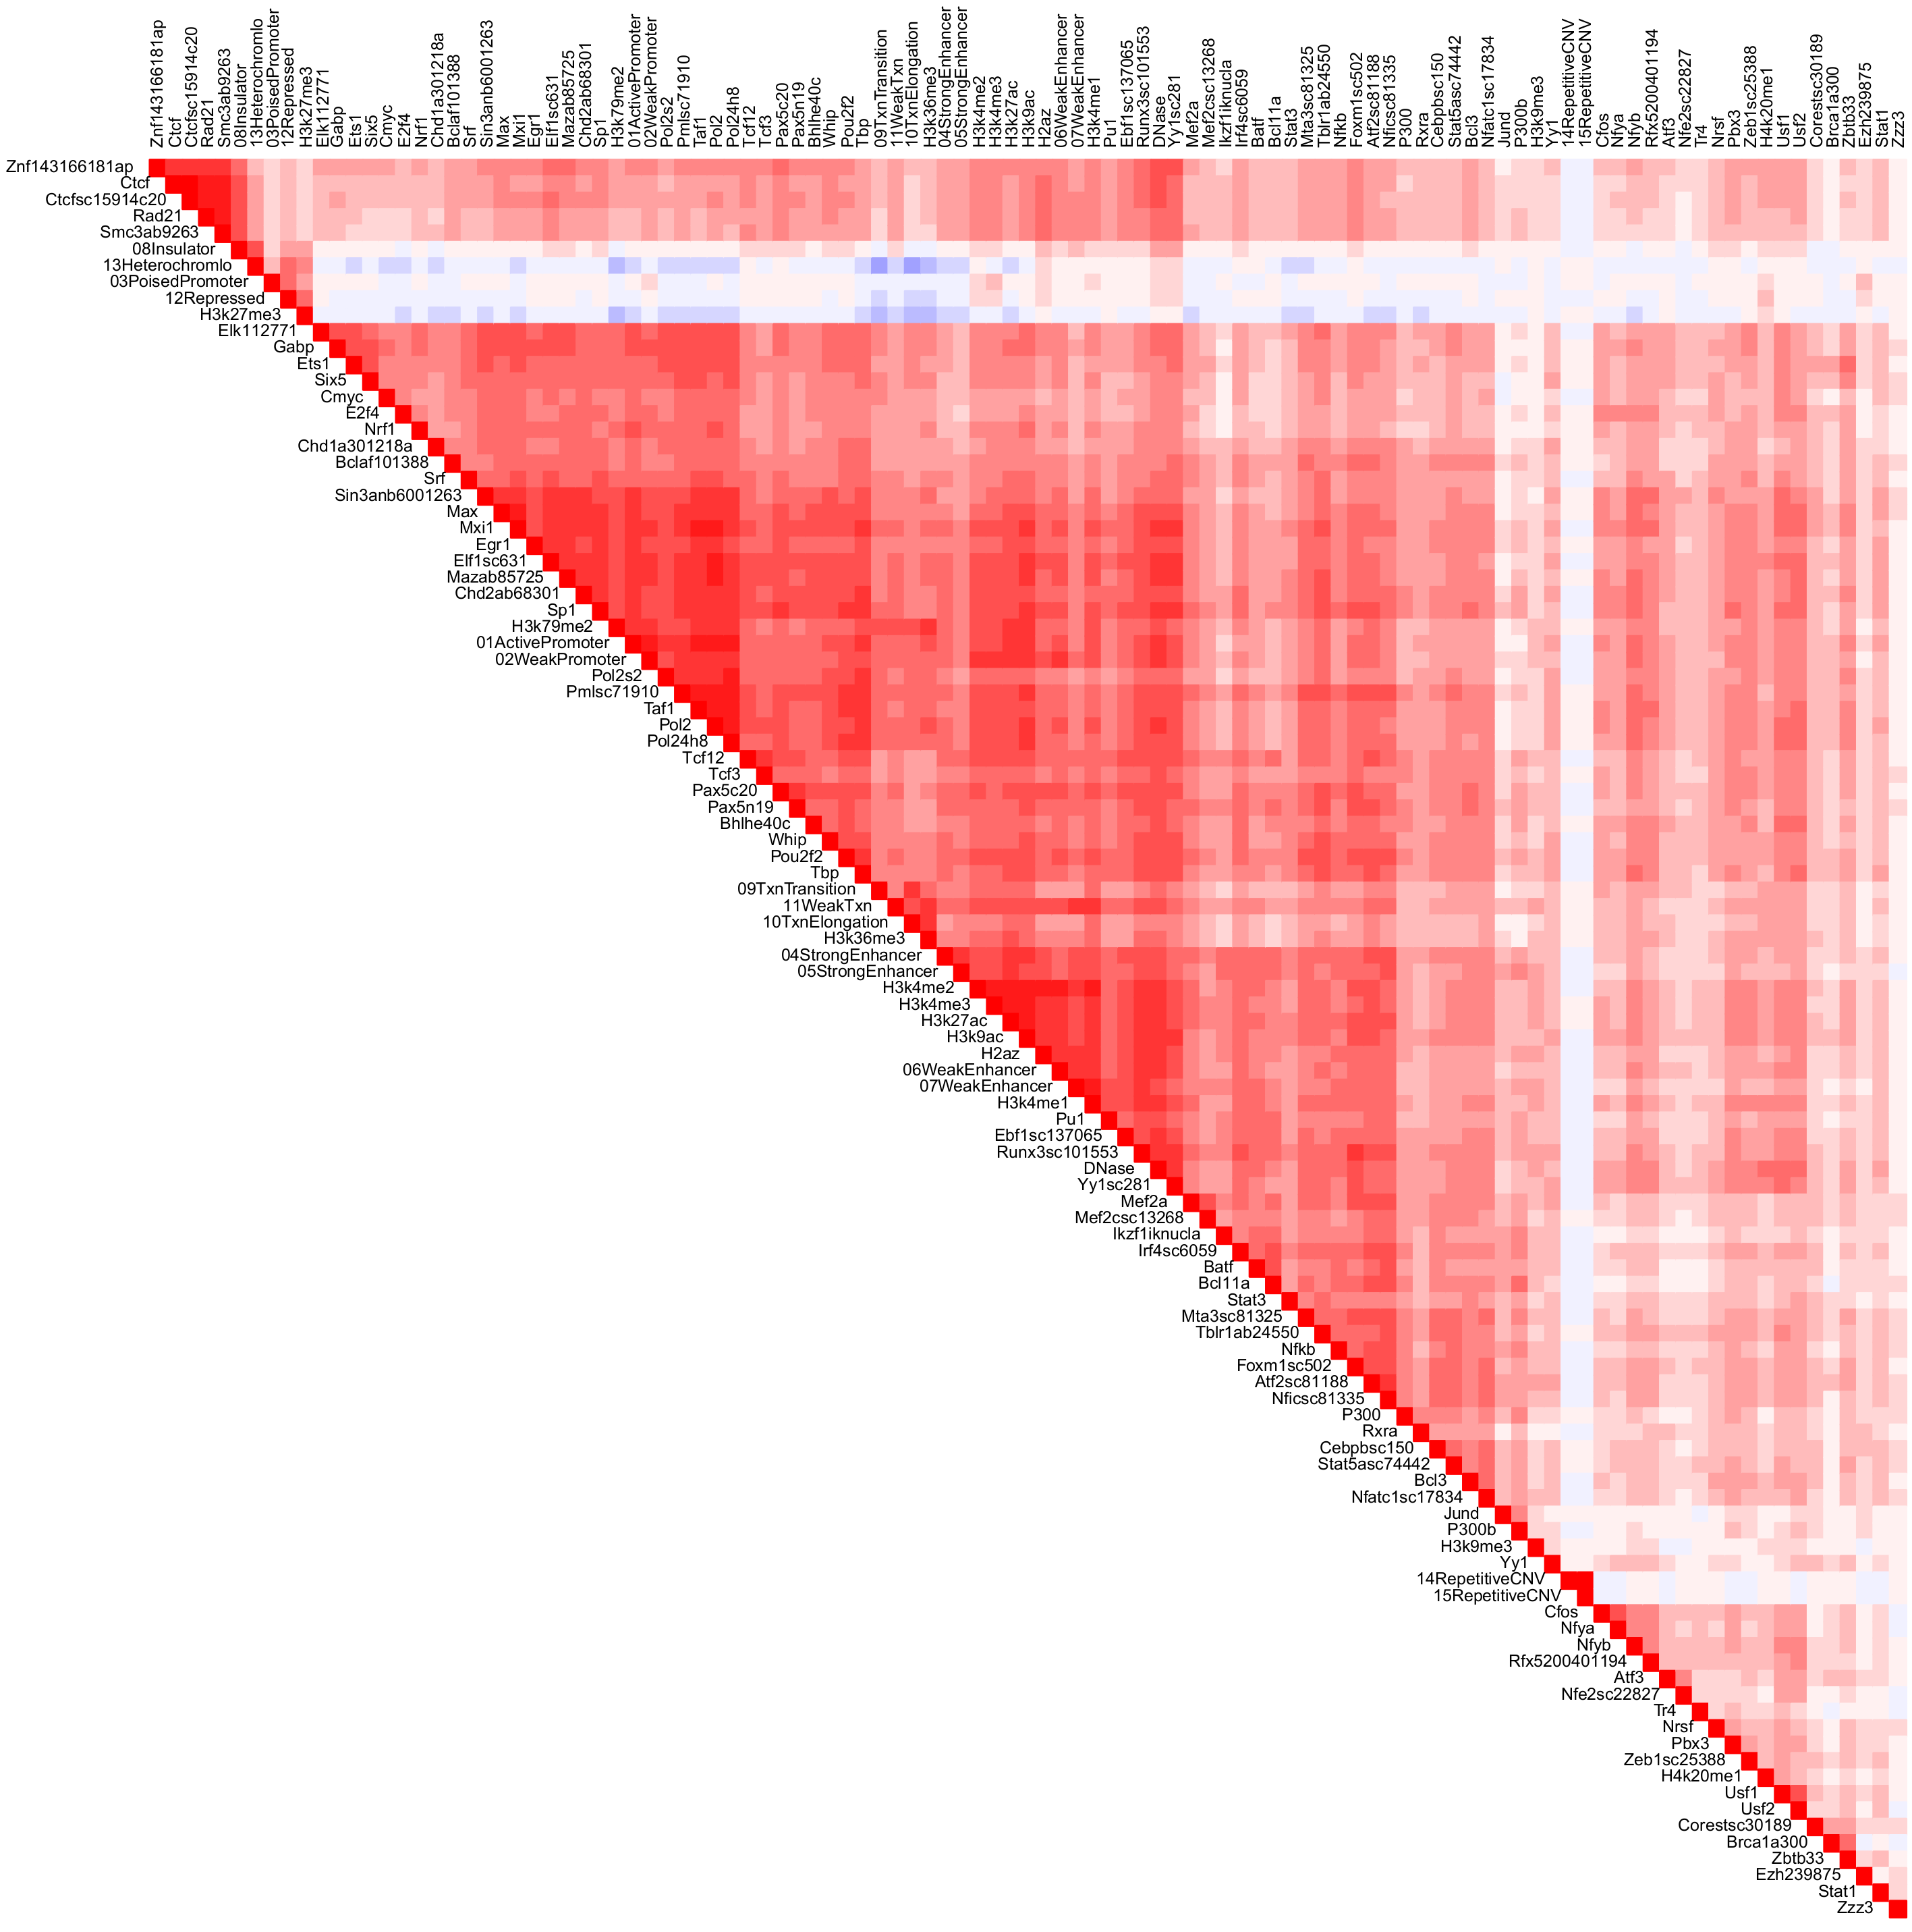
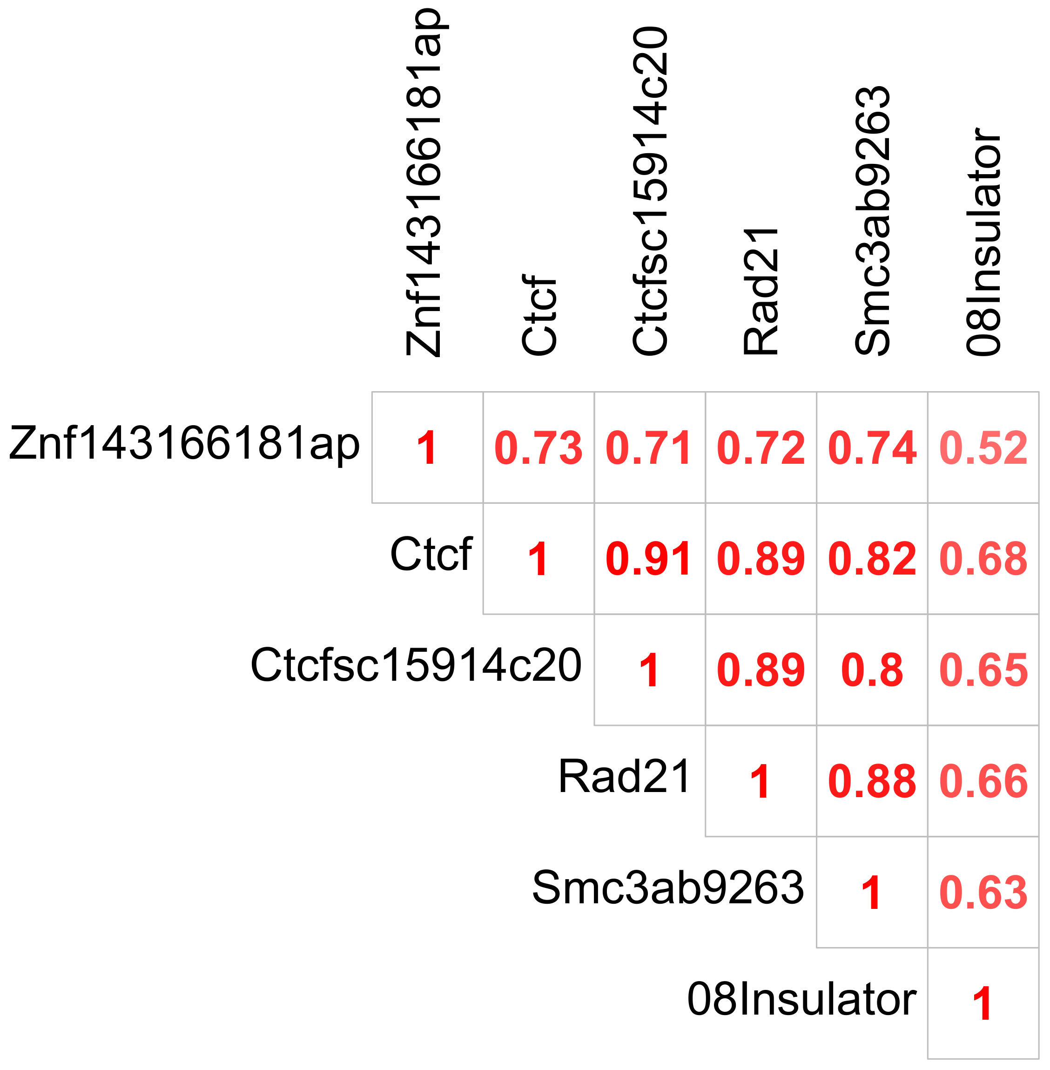
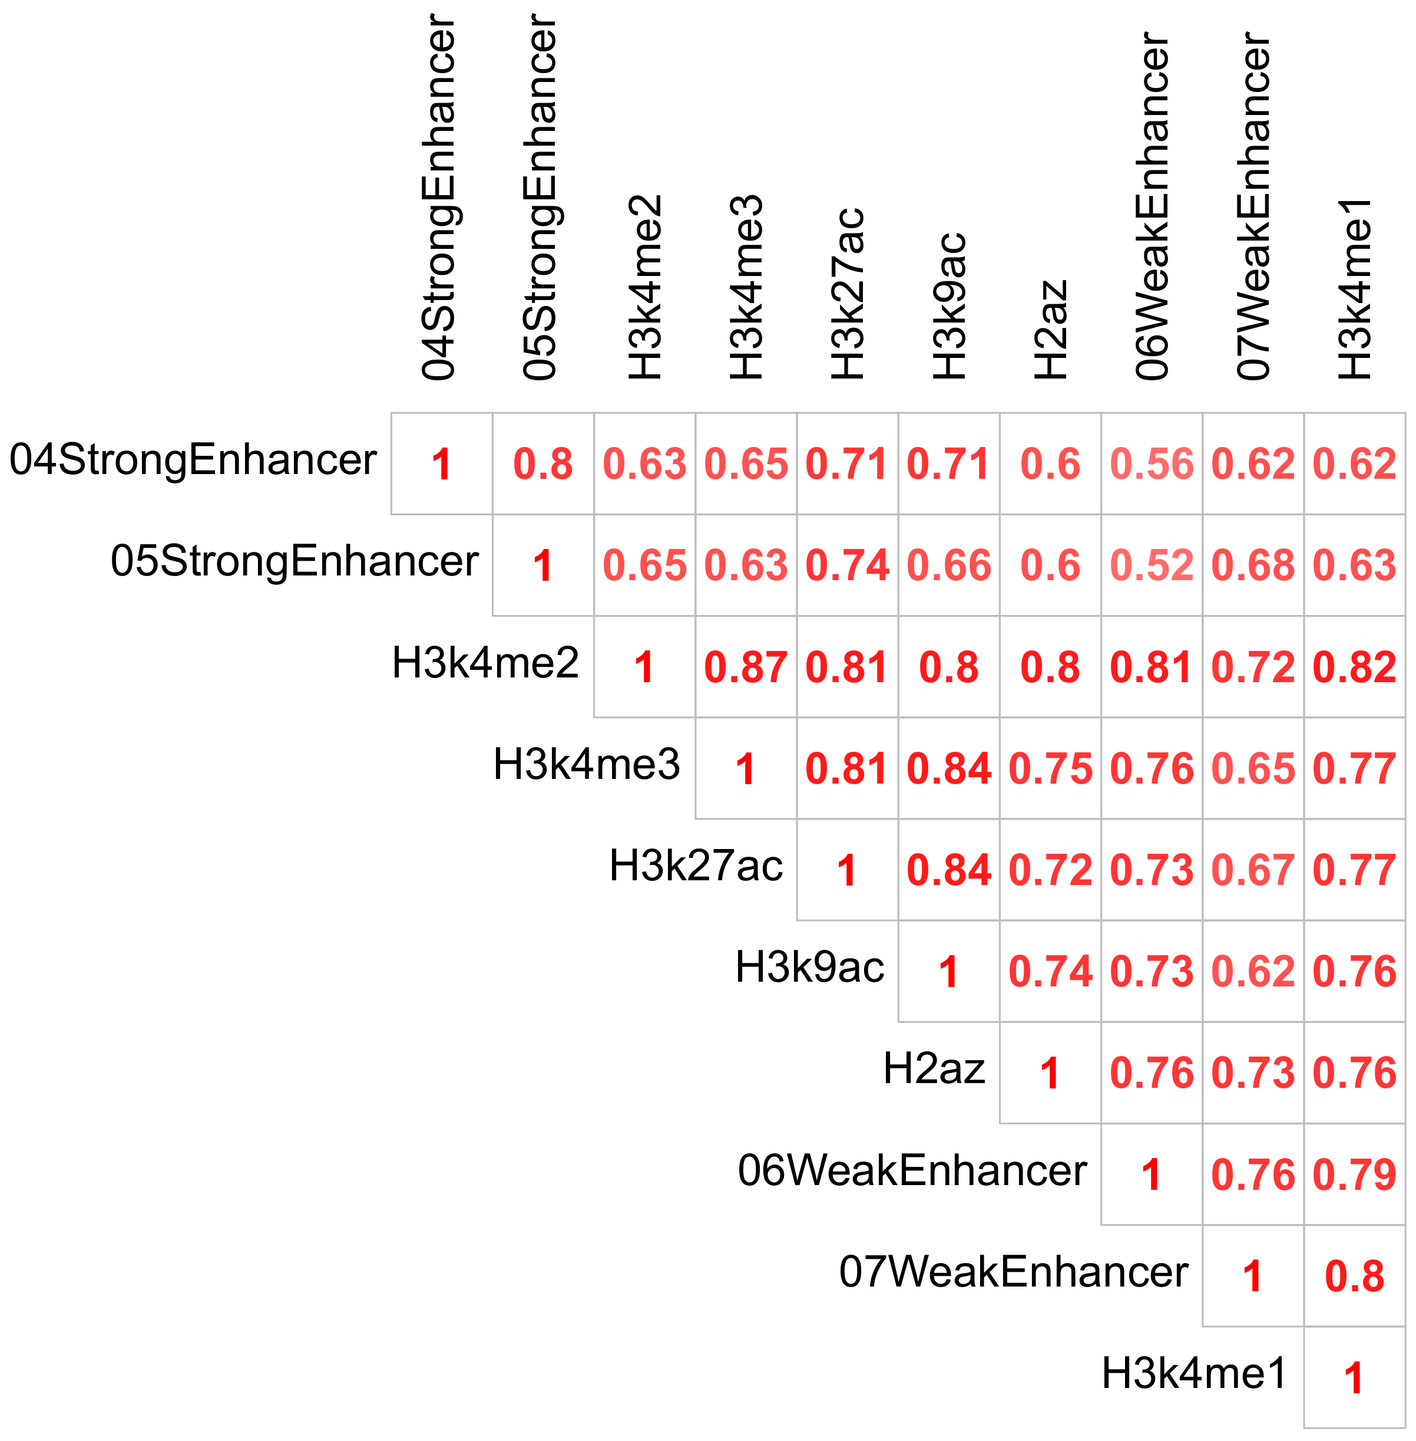
High Correlations Imply Colocalized Annotations Around TAD Boundaries

Slide 29
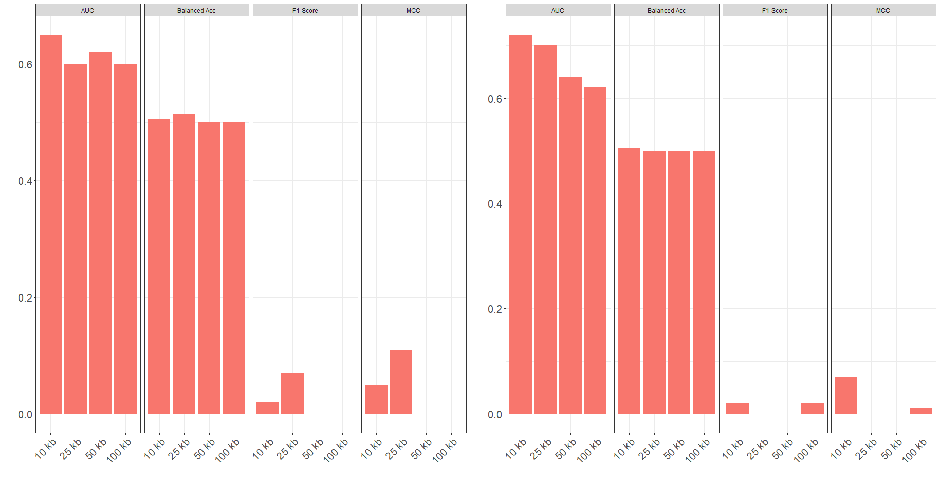
Class Imbalance Severely Impacts Model Performance Across Resolutions
More info

Slide 30
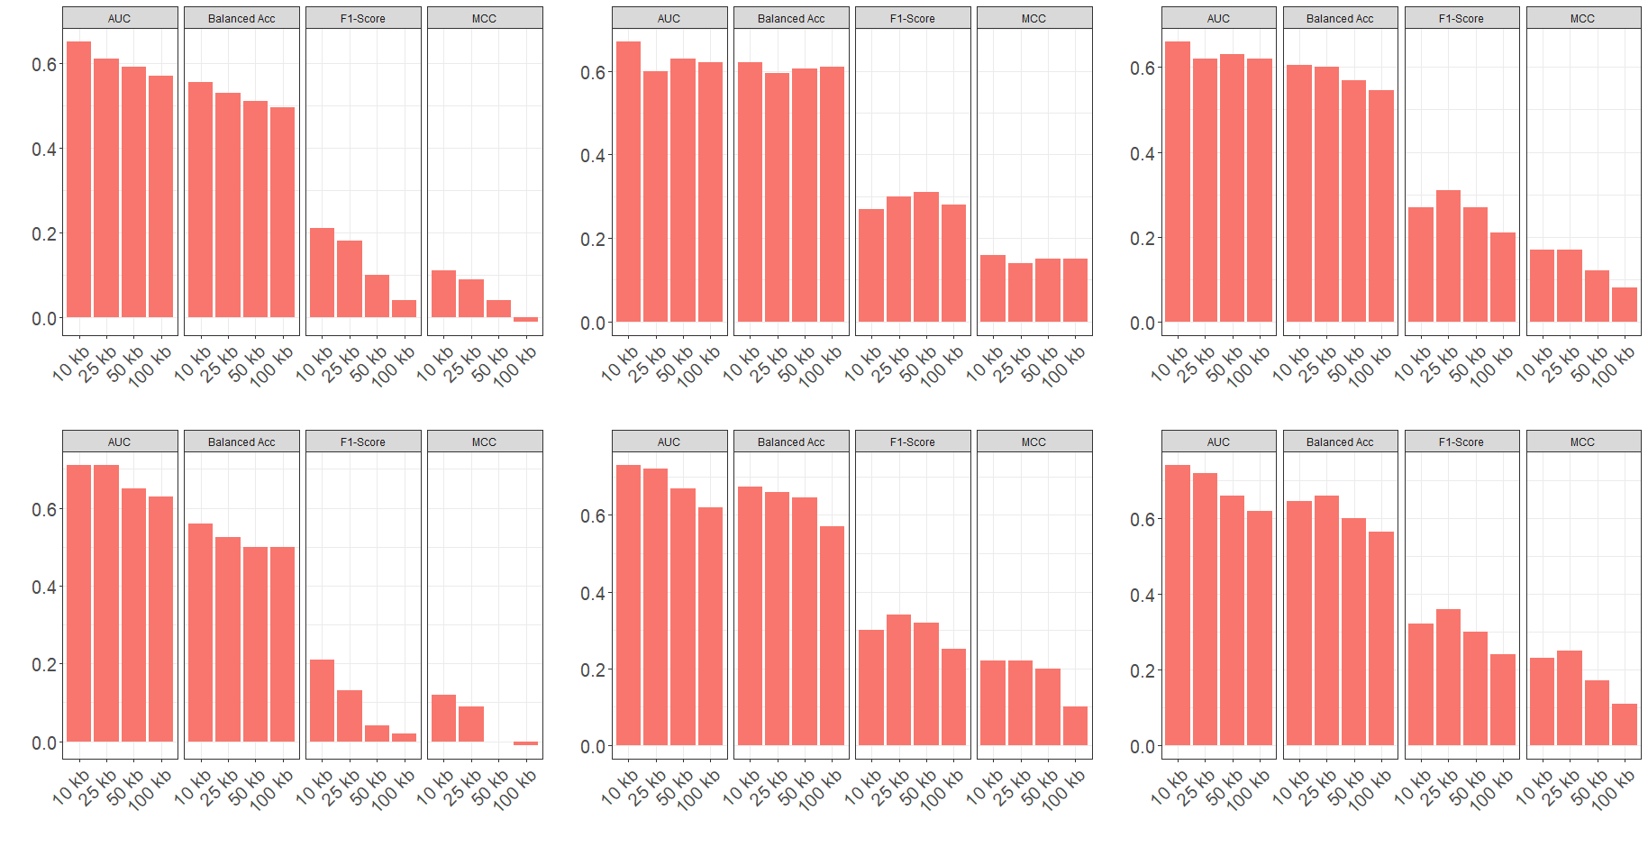
Data Re-Sampling Drastically Improves Model Performance

Slide 31
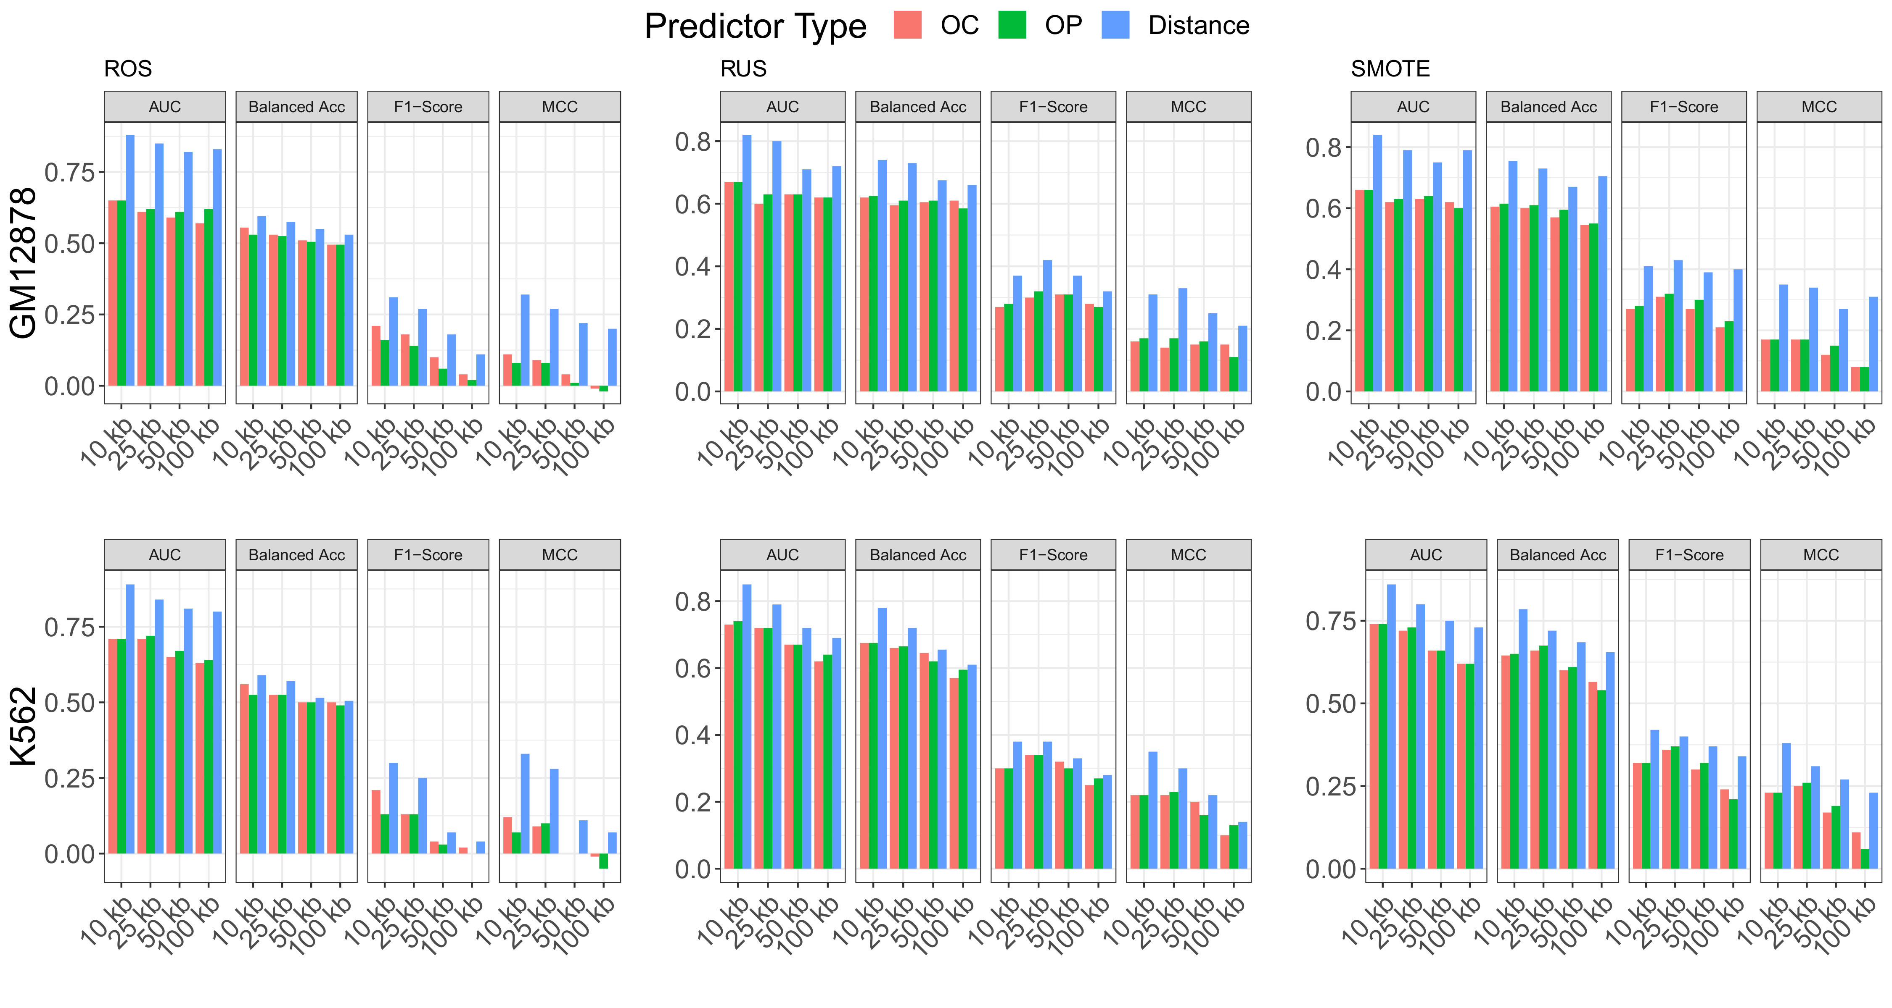
Distance-Type Predictors Further Improve Model Performance

Slide 32
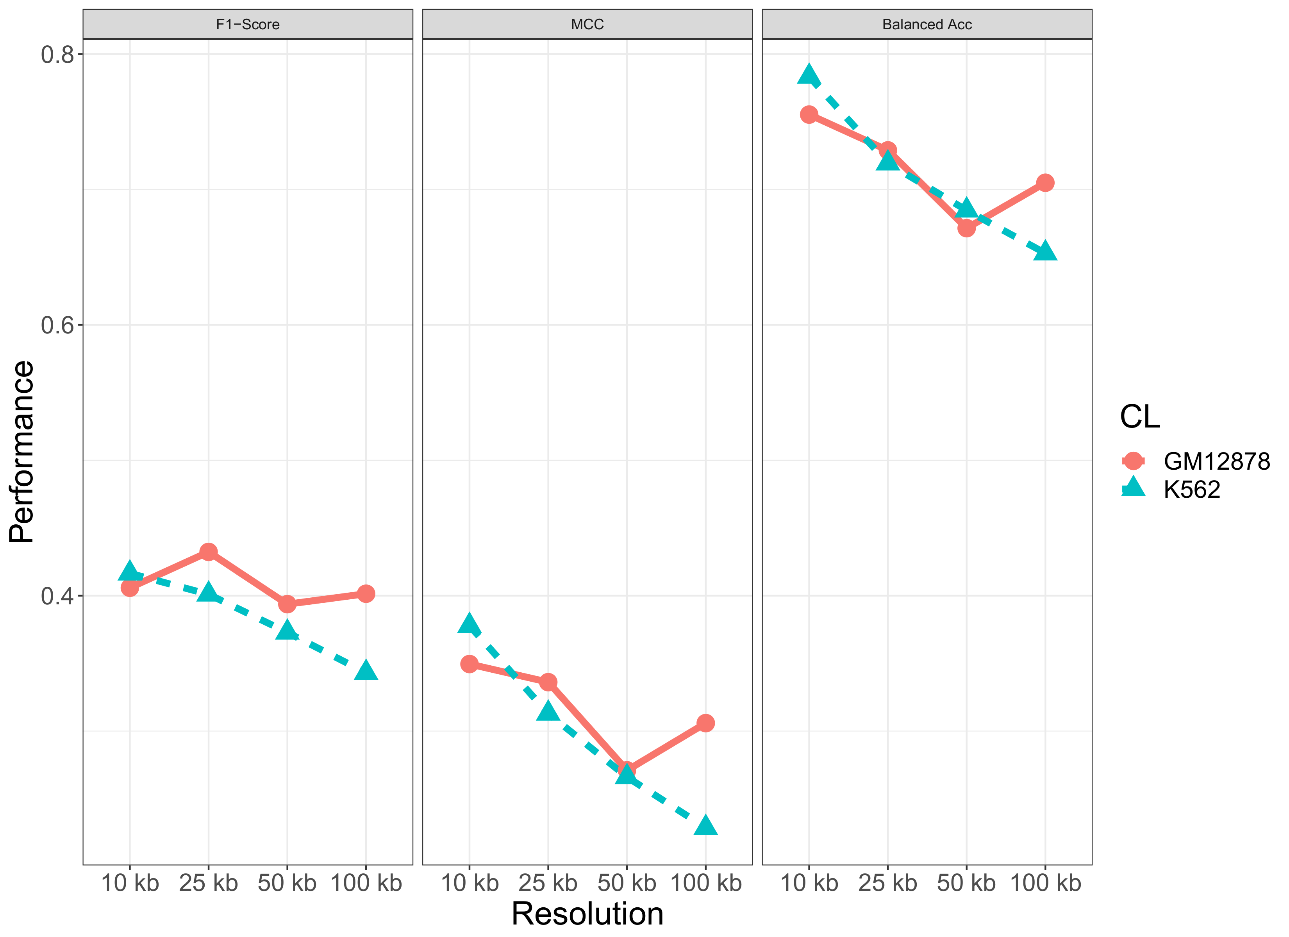
Models Implemented on SMOTE Re-Sampled Data with Distance-Type Predictors Performed Best
More info

Slide 33
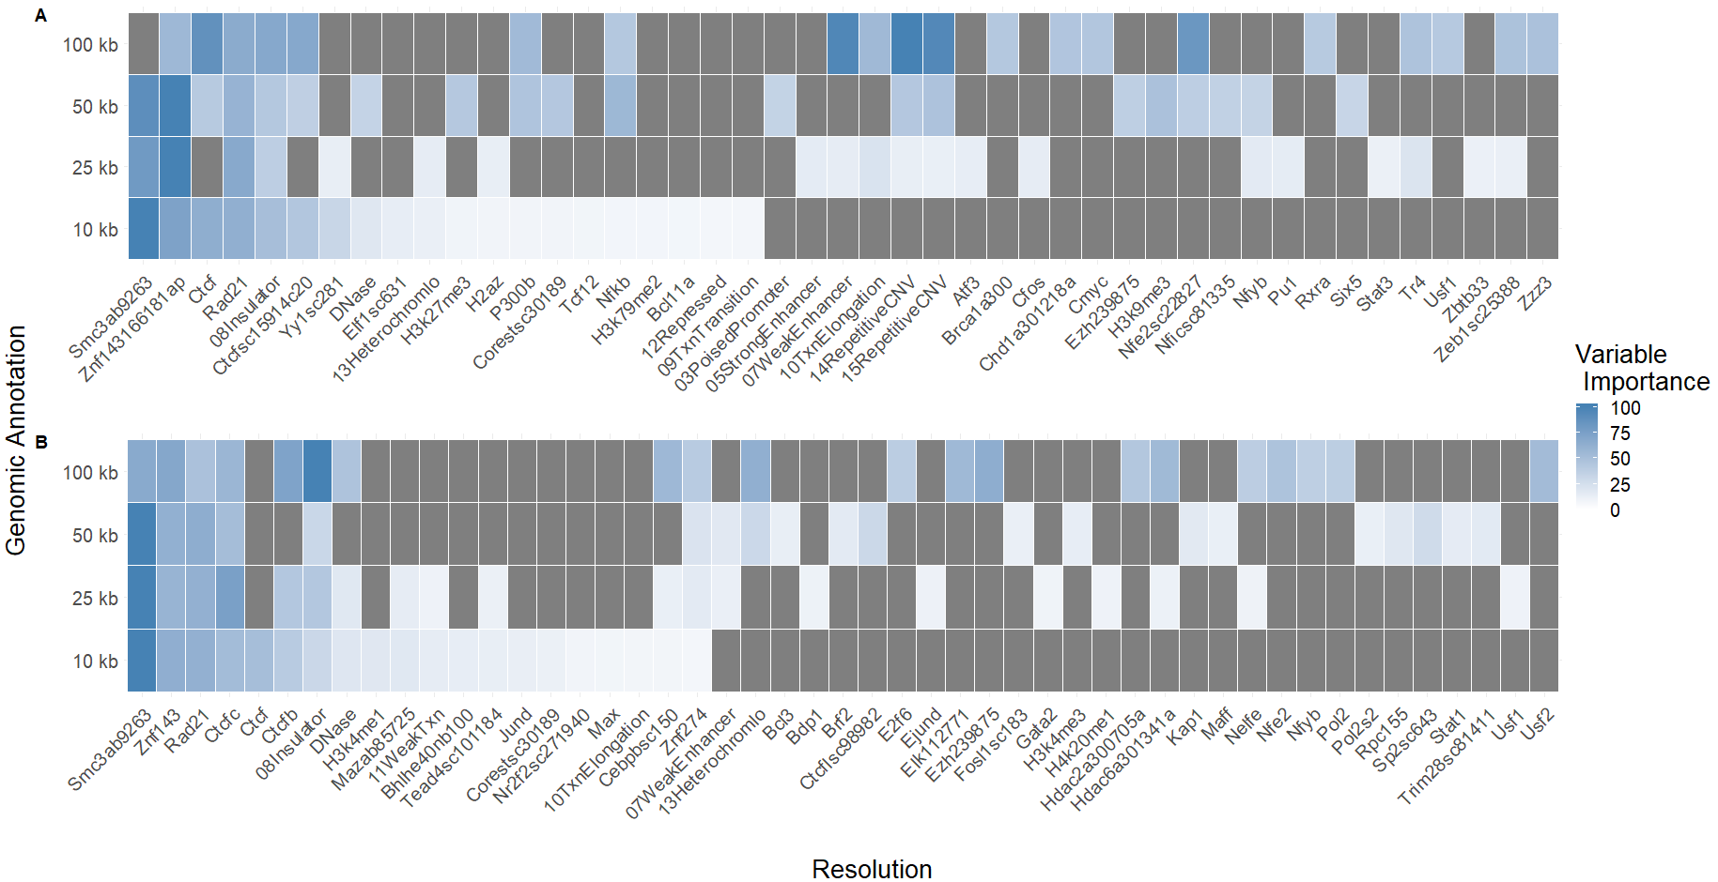
Variable Importances Confirm Familiar Biological Signficance

